Slide 1
SOUTHERN POWER DISTRIBUTION COMPANY (GSM Based Monitoring And Billing System)
Notes:
Tgfjhgf

Slide 2
TEAM NAME
TEAM AWESOME……..!!

Slide 3
TEAM MEMBERS
Aditya M Anand (NEC0912001) (LEADER)
Athun V.M (NEC0912016) (DEPUTY LEADER)
Manoj Mali (NEC0912037)
Gayathri M (NEC0912027)
Jeevanandam K (NEC0912031)
Jishnunand P.K (NEC0912032)

Slide 4
Introduction
The objective of this project is to replace the existing manual reading of electricity meters installed throughout the country (Home, Agricultural, and Industrial).
The proposed solution is to build a server for the Electricity boards in each state where the custom built GSM meters would update in real time through SMS.

Slide 5
Vision of the project
The idea of the developing the application is to provide support for the new post-paid meters, managed remotely by SMS based on GSM.
This application also provides a facility for the customers like online bill payment.

Slide 6
Scope of the project
It is particularly applicable for developing and underdeveloped countries where such a post-payment solution may be desirable.
It can solve all the standard business problems existing in operation and maintenance of utilities that use a post payment system.

Slide 7
Proposed System

Slide 8
GSM Device Functionality
SIM Toolkit programmed into the special GSM SIM card essentially enables the SIM card to drive the GSM handset interface, build up an interactive exchange between a network application and the end user and access or control access to the network.
The meter communicates the energy usage to the server the intelligence calculates the monetary value to be to be paid.

Slide 9
System Functionality
Application is capable of receiving messages(SMS) from the GSM device. It analyze the message
and calculates the amount to be paid.
Ideally, at intervals prior to disconnect, the system will warn the end user that only a short period of time is left before the credit is depleted.

Slide 10
Customer functionality
He can view the previous bills and current bills
Pay the bill online.

Slide 11
Development Architecture
Front End → JSP, HTML5, CSS
Database → MySQL 5.6
Scripting language → JQuery, Bootstrap
Web Server → Apache Tomcat Server6.0
Operating System → Windows 7 and higher version
IDE → Eclipse with my Eclipse plugins
Third Party Software→ Ozeking SMS Gateway
Social Services → Gmail Services for sending mail
Browsers → IE8/8+,Chrome15+,Safari 4+,Mozilla Firefox

Slide 12
Software requirements
Operating System -Windows 7 and higher version
IDE - Eclipse with my Eclipse plug ins
Text editor -Sublime text3
Browsers –IE8/8+,Chrome15+,Safari 4+,Mozilla Firefox

Slide 13
Minimum Hardware Requirements
Processor :Intel dual core
Hard disk :80gb
Ram :2GB

Slide 14
Modules
we can divide the system into the following modules such as:
Users Module
Super Admin
Administrators Module

Slide 15
USER SUB MODULES
LOGIN
VIEW BILLS
CUSTOMER DETAILS
FEEDBACK/COMPLAINTS
LOG OUT

Slide 16
ADMIN SUB MODULES
LOGIN
CREATE/DELETE USER
GENERATE BILLS
SEND SMS TO CLIENTS
SEND AKNOWLEDGEMENT TO USERS
VIEW CLIENT QUERIES
SEND RESPONSE TO CLIENT QUERIES
PAYMENT
LOG OUT

Slide 17
SUPER ADMIN SUB MODULES
Login
Create Admin
Manage Admin
Logout

Slide 18
Modules
Users Module:
All users need to supply user name and password to login to the system. Like Agriculturists (Agricultural users), Industries (Industrial users), Electricity Boar– Administrators, Electricity Board – Officers, Municipalities/ Municipal Corporations/ Panchayats.

Slide 19
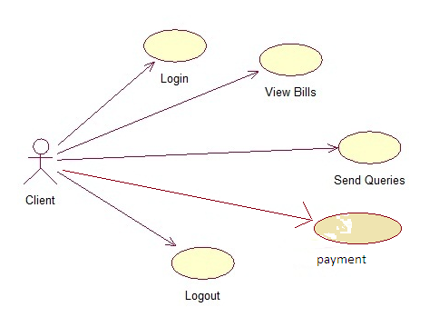
User Usecase

Slide 20
Modules
Administrator Module:
This module maintains the services related to system administrator who is authenticated upon the system.
This module fairly maintains the integration between the modules related to backend database and the functionalities carried out in the whole organization.
This module also binds itself with the employees and branch details.

Slide 21
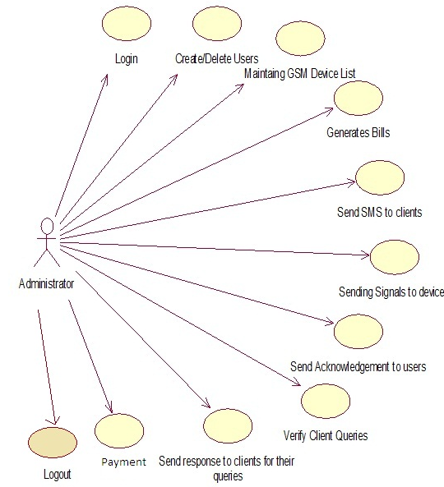
Admin Usecase

Slide 22
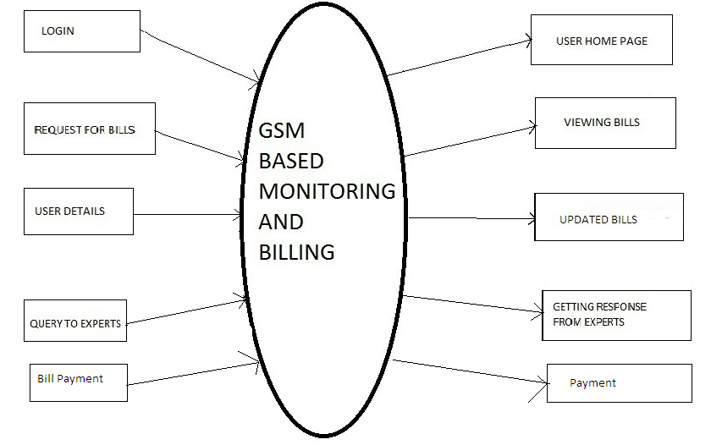
USER FUNCTIONALITY

Slide 23
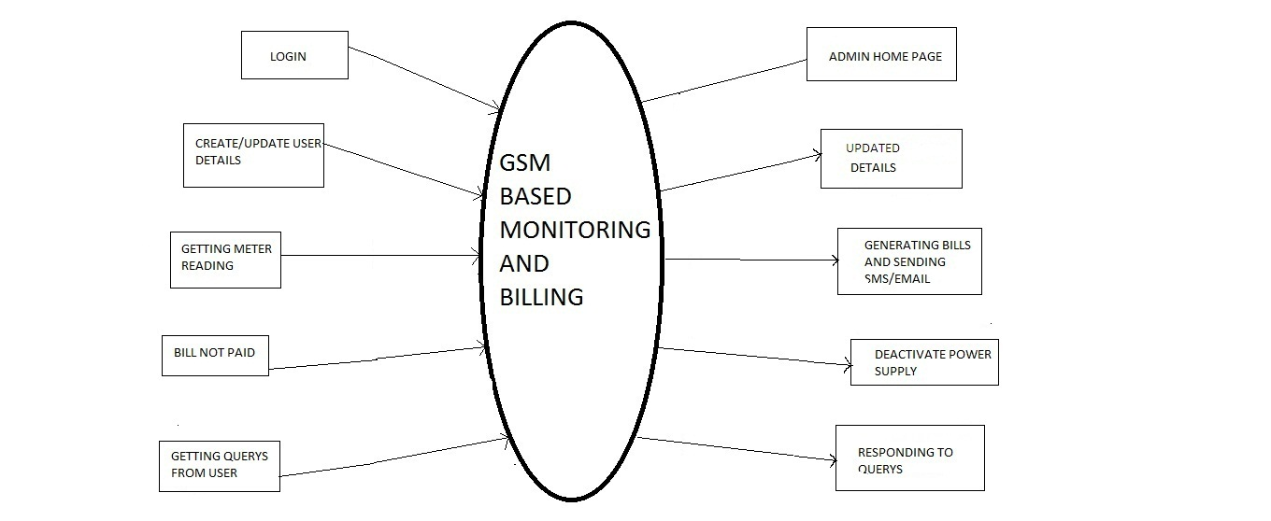
ADMIN FUNCTIONALITY

Slide 24
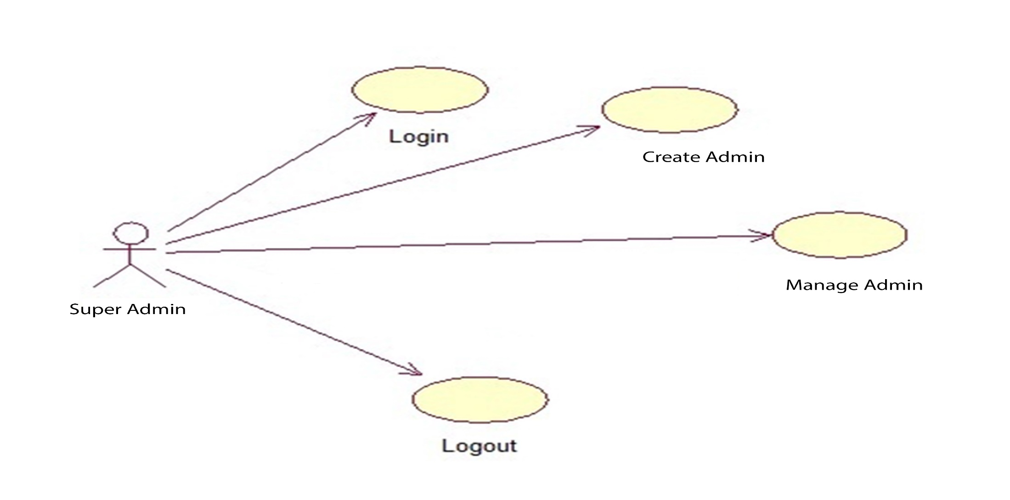
SUPER ADMIN USE CASE:

Slide 25
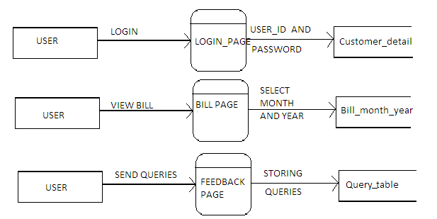
DFD

Slide 26
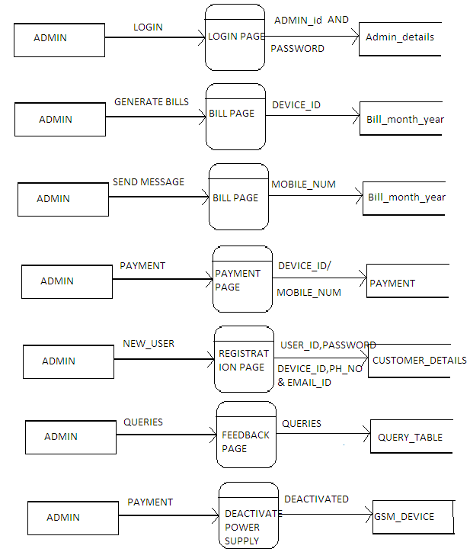
DFD

Slide 27
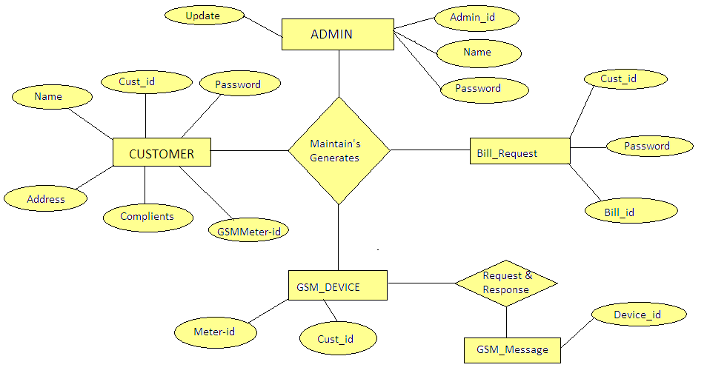
ER-Diagram

Slide 28
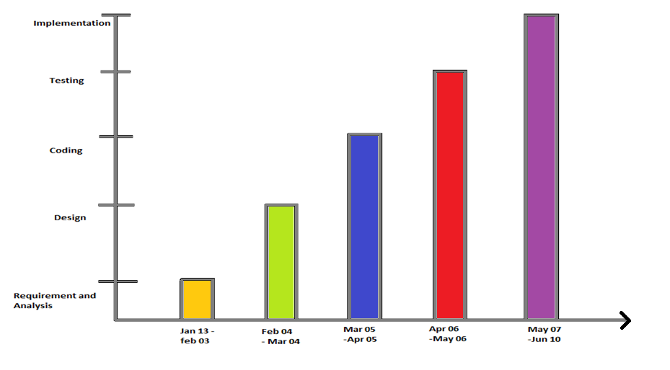
GANTT CHART

Slide 29
Advantages & Conclusion
It provides an advantage and support the concept of e-governance in the electric reading and metering. Our system provides the customer precise consumption information. It gives accurate billings. Provides better and fast customer service. It reduces man power and time consumption.

Slide 30
GSM based Remote Monitoring and Billing
Queries?

Slide 31
Thank You

